Slide 1
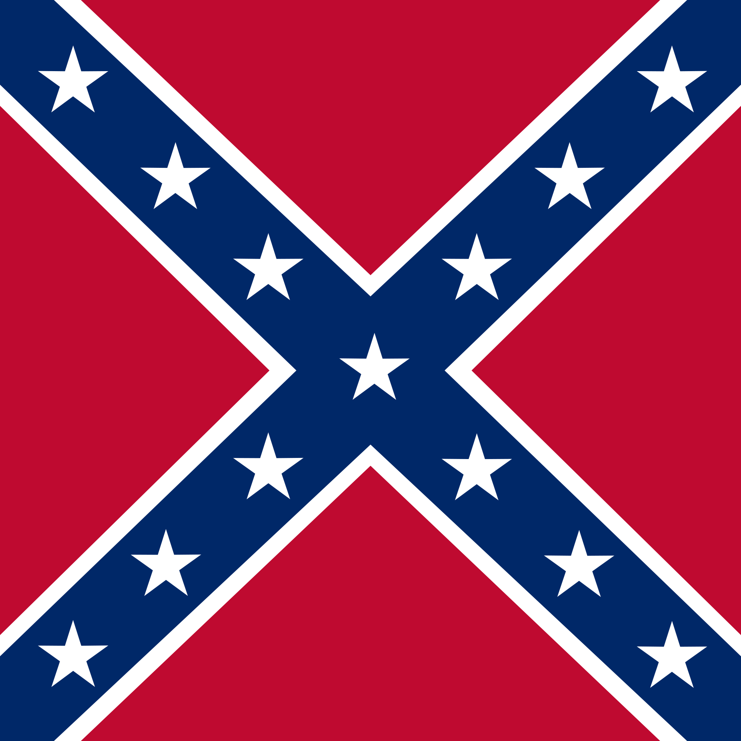
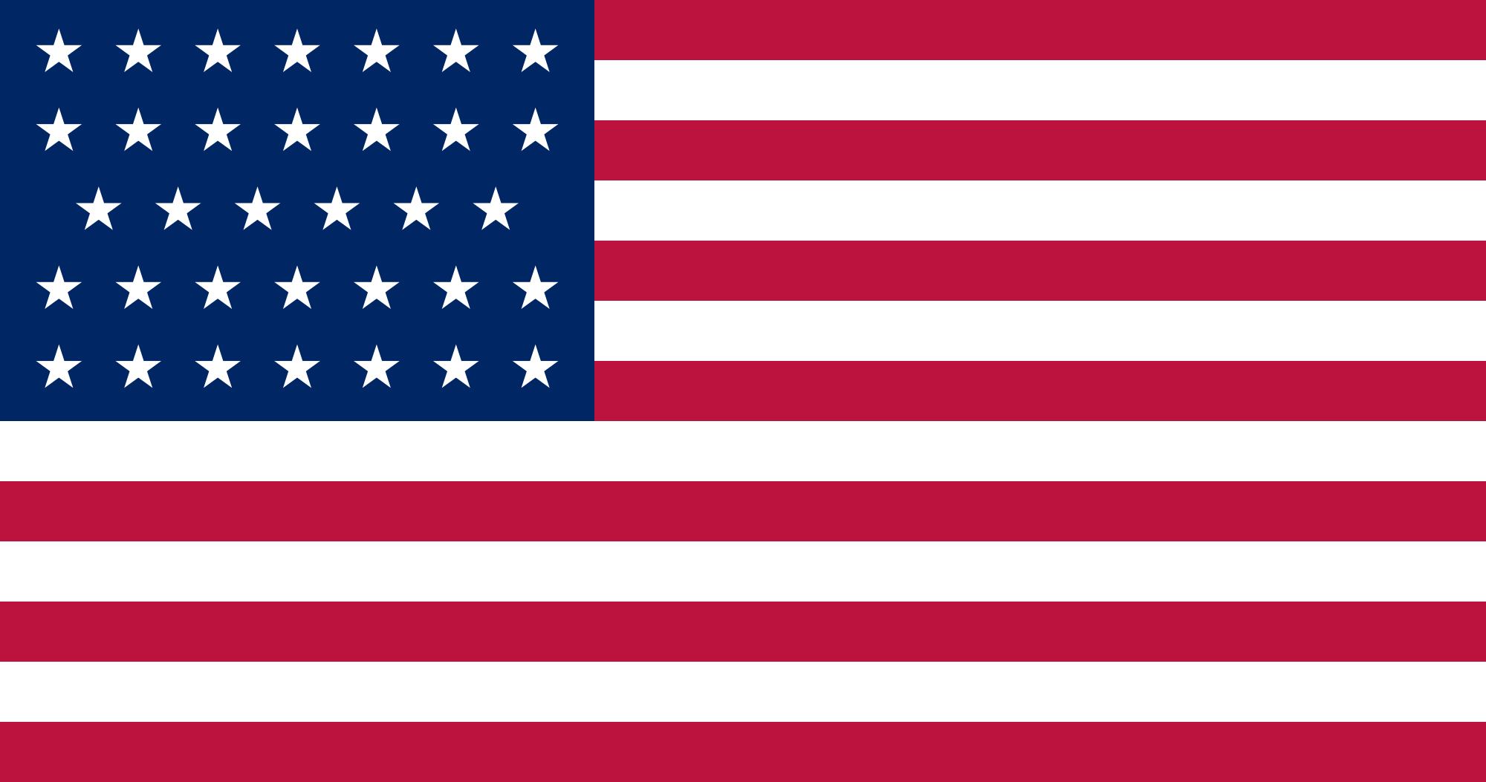
Civil War Timeline (1861-1865)
* - Battles researched
By:
Neel Balusa
Rohan Dharmadhikari
Vinay Deshmukh

Slide 2
Title of Battle or Event
Confederate Win
Union
Win
Total Forces: xxx,xxx X-X odds
Confederates: xxx
Union: xxx
Generals
Confederates: X
Union: X
Casualties
Confederates: xxx
Union: xxx

Slide 3
Battles/Events in 1861
Fort Sumter
Bull Run/First Manassas*
Fort Washington
Wilson Creek
Lexington*

Slide 4
Bull Run/First Manassas
-Rohan
July 21st 1861
Total Forces: 55,680 1-1 odds
Confederate: 32,230
Union: 23,450
Generals
Confederate
Joseph E. Johnston
P.G.T Beauregard
Union
Irvin Mcdowell
Casualties:
Union: 2896
Confederate: 1892

Slide 5
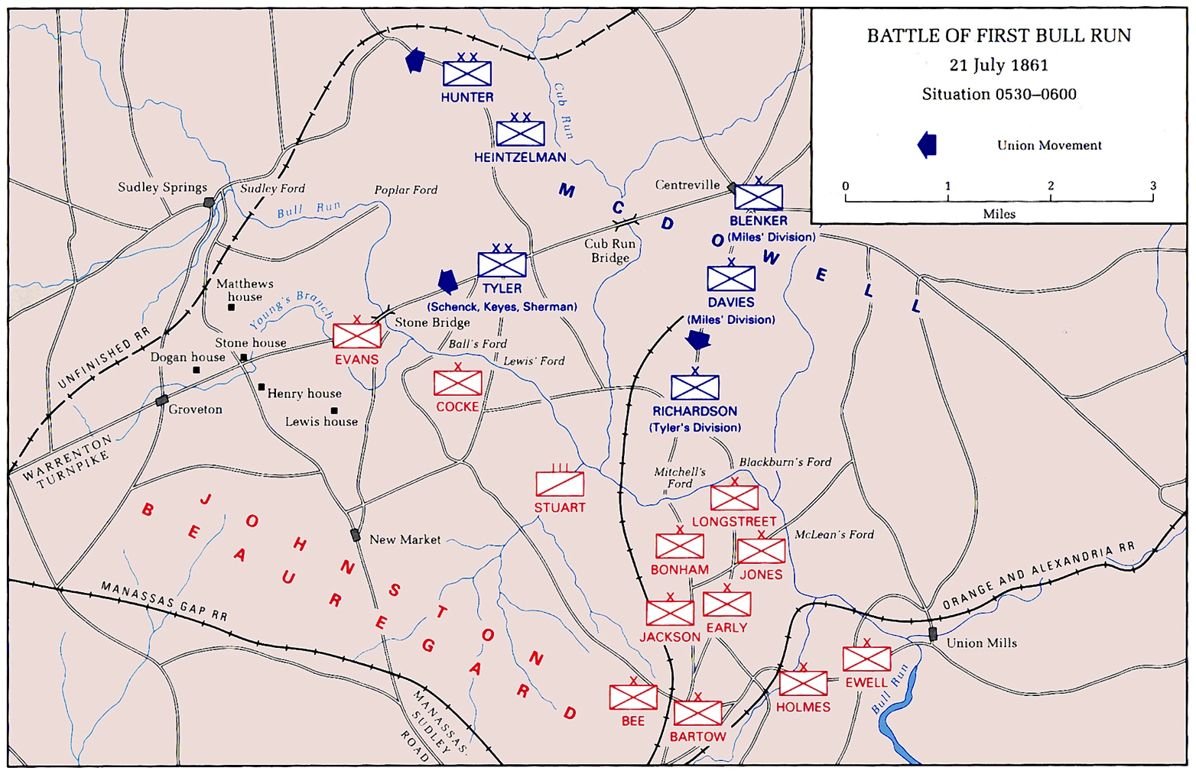

Slide 6
Lexington
-Vinay
September 12th 1861
Total Forces: 23,500 6-1 odds
Confederate: 20,000
Union: 3,500
Generals
Confederate
Claiborne Fox Jackson
Sterling Price
Union
James A. Mulligan
Robert T. Van Horn
Casualties
Confederate: 100
Union: 1,774

Slide 7
Battles/Events 1862
Battle of Roanoke Island
Fort Donelson*
Battle of Pea Ridge
Shiloh*
Battle of seven Pines
Second Bull Run/Manassas*
Antietam*
Fredericksburg*

Slide 8
Fort Donelson
-Neel
February 11-16th, 1862
Total Forces: 40,702 1-1.5 odds
Confederate: 16,171
Union: 24,531
Generals
Confederate
Gideon J. Pillow
John Buchannan Floyd
Simon Bucker
Union
Andrew Hull Foote
Ulysses S. Grant
Casualties
Confederate: 13,846
Union: 2,691

Slide 9
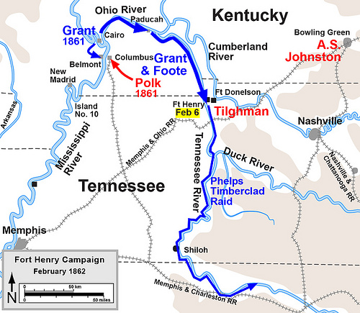

Slide 10
Shiloh
-Rohan
April 6th-7th 1862
Total forces: 110,053, 1-1.5 odds
Confederate: 44,968
Union: 65,085
Generals
Confederate
Albert Sidney Johnston
P.G.T Beauregard
Union
Don Carlos Buell
Ulysses S. Grant
Casualties:
Confederate: 10,669
Union: 13,047

Slide 11
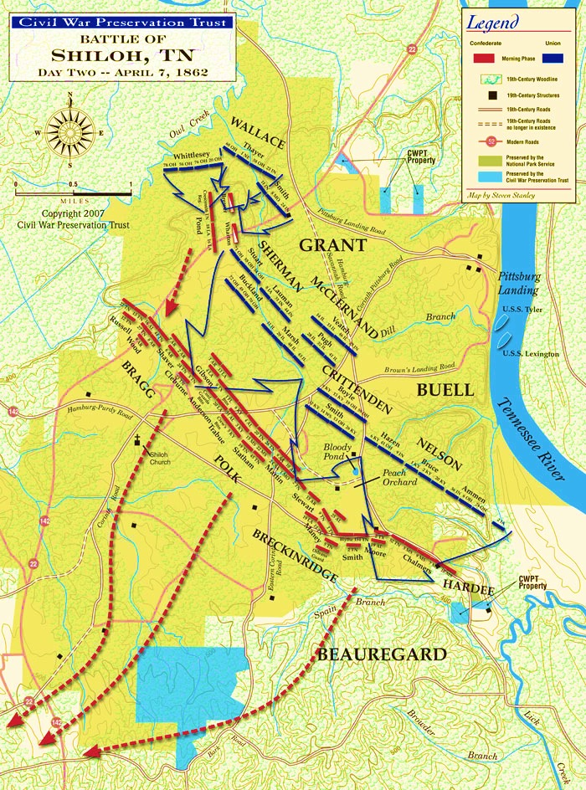

Slide 12
Second Bull Run/Manassas
-Rohan
August 28th 1862
Total Forces: 125,000 1-1 odds
Confederate: 55,000
Union: 70,000
Generals
Confederate: Robert E. Lee
Union: John Pope
Casualties
Confederate: 1,305
Union: 1,716

Slide 13
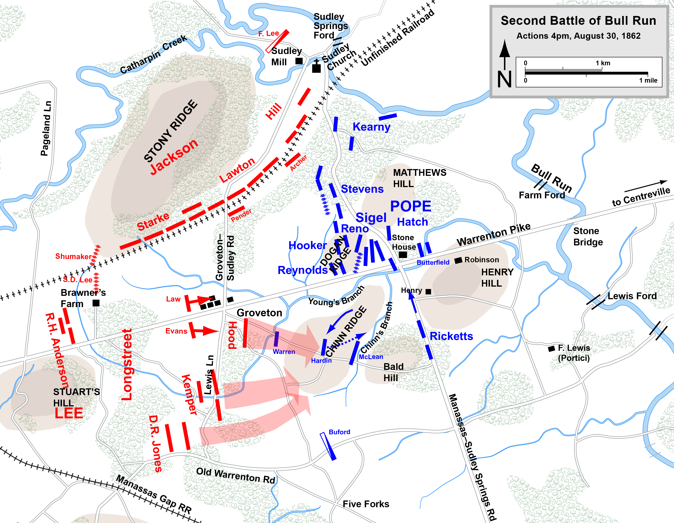

Slide 14

Antietam
-Vinay
September 16th-18th 1862
Total Forces: 131,000 1-2 odds
Confederate: 45,000
Union: 87,000
Generals:
Confederate: Robert E. Lee
Union: George B. McClellan
Casualties
Confederate: 10,316
Union: 12,401

Slide 15
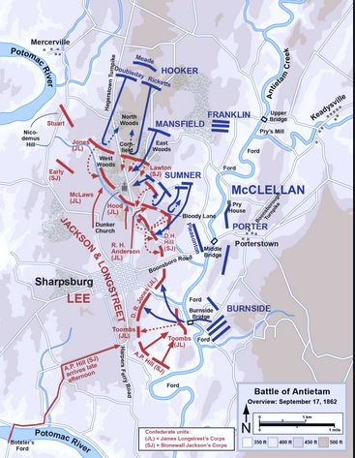

Slide 16
Fredericksburg
-Neel
December 11-15 1862
Total Forces: 172,954 1-1.5 odds
Confederate: 72,947
Union 100,007
Generals
Confederate: Robert E. Lee
Union: Ambrose E. Burnside
Casualties
Confederates: 4,576
Union: 13,353

Slide 17
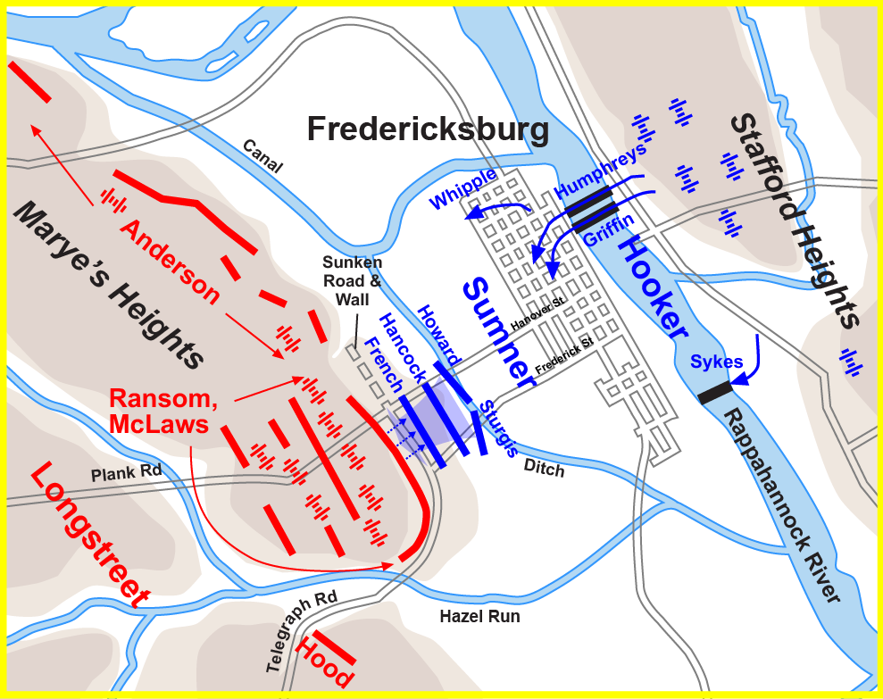

Slide 18
Battles/Events of 1863
Emancipation Proclamation*
Chancellorsville*
Second Winchester
Gettysburg*
Vicksburg Captured*
Draft riots
Chattanooga
Chickamauga*
Knoxville

Slide 19
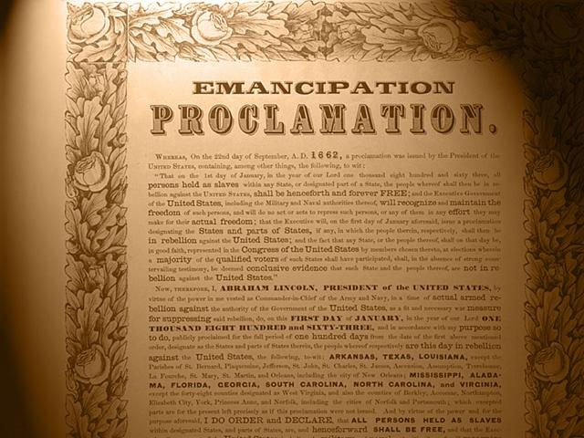
Emancipation Proclamation
-Vinay

Slide 20
Chancellorsville
-Rohan
April 30th - May 6th 1863
Total Forces: 154,734 1-1.5 odds
Confederate: 57,352
Union: 97,382
Generals:
Confederate
Robert E. Lee
Stonewall Jackson
Union
Joseph Hooker
Casualties
Confederate: 1,724
Union: 1,694

Slide 21
Gettysburg
-Neel
July 1-3 1863
Total forces: 165,620 1-1.5 odds
Confederate: 71,699
Union: 93,921
Generals
Confederate: Robert E. Lee
Union: George G. Meade
Casualties
Confederate: 28,063
Union: 23,049

Slide 22
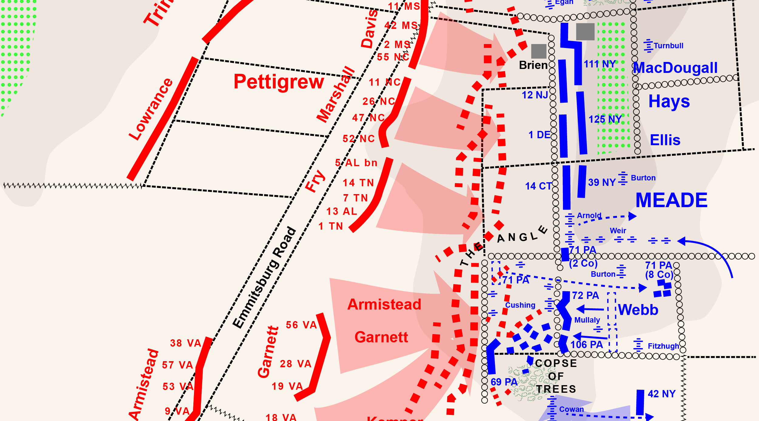
Pickets Charge

Slide 23
Vicksburg Captured
-Neel
May 18 – July 4th 1863
Total Forces: 110,000 1-2 odds
Confederate: 33,000
Union: 77,000
Generals
Confederate: John C. Pemberton
Union: Ulysses S. Grant
Casualties
Confederate: 32,492
Union: 4,910

Slide 24
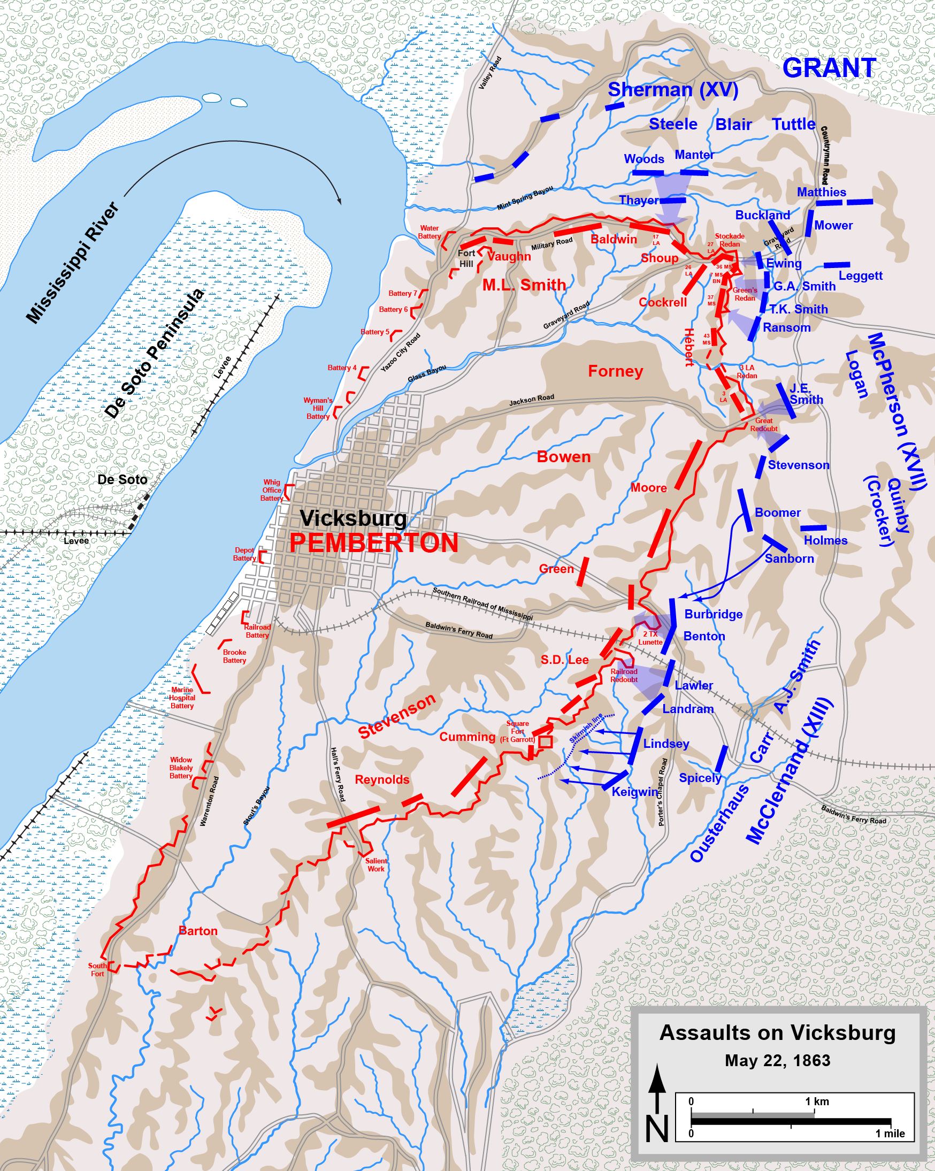

Slide 25
Chickamauga
-Vinay
September 12th-20th 1863
Total Forces: 125,000 1-1 odds
Confederate: 65,000
Union: 60,000
Generals:
Confederate: Braxton Bragg
Union: William S. Rosecrans
Casualties
Confederate: 2,312
Union: 1,657

Slide 26


Battles/Events of 1864
Meridian
Charleston: submarine attack
Grant appointed general of Potomac
Pleasant hill
Fort pillow*
Wilderness
Spotsylvania
Cold harbor
Brice's crossroads
Mobile bay
Atlanta falls
Cedar creek
Nashville*

Slide 27
Fort Pillow
-Neel
On April 12th 1864
Total Forces: 3,100 4-1 odds
Confederate: 2,500
Union: 600
Generals
Confederate: Nathan Bedford Forrest
Union: None (Garrison)
Casualties
Confederate: 100
Union: 600

Slide 28
Nashville
-Rohan
December 16th 1864
Total Forces: 85,000 1-2 odds
Confederate: 30,000
Union: 55,000
Generals
Confederate: John Bell Hood
Union: George Thomas
Casualties
Confederate: 6,000
Union: 3,061

Slide 29
Battles/Events of 1865
Assault of fort fisher
Columbia south Carolina
Fall of Petersburg*
Battle of five forks
Appomattox Courthouse*
Lincoln Assassinated*
Jefferson Davis captured
Palmetto Ranch*

Slide 30
Fall of Petersburg
-Rohan
April 2nd, 1864
Total Forces: 134,513 1-1.3 odds
Confederate: 58,400
Union: 76,113
Generals
Confederate: Robert E. Lee
Union: Ulysses S. Grant
Casualties
Confederate: 4,250
Union: 3,500

Slide 31
Appomattox Courthouse
-Vinay
April 9th, 1865
Total Forces: 89,285 1-2.5 odds
Confederate: 26,000
Union: 63,285
Generals
Confederate: Robert E. Lee
Union: Ulysses S. Grant
Casualties:
Confederate: 500
Union: 158

Slide 32
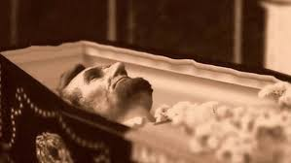
Lincoln Assassinated
-Neel
April 15th 1865
John Wilkes Booth shot Lincoln In the head
Lincoln died at a theater event
The whole Union was shaken
Union soldiers tracked Booth down a week later

Slide 33
Palmetto Ranch
-Vinay
The Battle of Palmetto Ranch was a relatively un-important battle though it was the last battle of the civil war.
Casualties
Confederates: 6
Union: 118
UNION
☹
WON ☹

Slide 34
Citations
www.nps.gov/gett/learn/historyculture/civil-war-timeline.htm
www.americancivilwar.com
www.nps.gov/abpp/battles/mo004.htm
www.civilwar.org/battlefields/wilson-s-creek.html
www.civilwaronthewesternborder.org/content/battle-Lexington
www.civilwar.org/battlefields/fort-donelson.html
www.civilwar.org/battlefields/shiloh.html
www.dailykos.com
www.thomaslegion.net
http://www.civilwar.org/battlefields/fredericksburg.html
http://www.civilwar.org/antietam.html

Slide 35
Citations
www.en.wikipedia.org
http://www.archives.gov/exhibits/featured_documents/emancipation_proclamation/
www.wach.com
http://www.historyrocket.com/American-History/civil-war/Why-Did-The-North-Win-The-Civil-War.html
http://commons.wikimedia.org/wiki/File:Second_Bull_Run_Aug29_1700.png
http://en.wikipedia.org/wiki/First_Battle_of_Bull_Run#/media/
http://thomaslegion.net/battleofchancellorsvillebattlefieldpositions.html
http://www.custermen.com/DixieBoys/FtPillow.htm
http://www.bonps.org/wpr/wp-content/uploads/2011/03/Kay-pix-Mar11-054-copy.jpg
http://commons.wikimedia.org/wiki/File:Petersburg_July30.png

Slide 36
Citations
http://www.civilwar.org/battlefields/nashville.html?tab=facts
http://www.civilwar.org/battlefields/bullrun.html?tab=facts
http://www.civilwar.org/battlefields/petersburg-breakthrough.html
http://www.civilwar.org/battlefields/second-manassas.html
http://www.civilwar.org/battlefields/chancellorsville.html
http://www.civilwaronthewesternborder.org/content/battle-lexington
http://www.historynet.com/battle-of-richmond

